Slide 1

Driver Drowsiness Detection System Using Arduino

Slide 2
Project analysis slide 2
Abstract
Nowadays Drowsiness is the main cause of road accidents due to less sleep or tiredness driver may fall asleep
According to the National Highway Traffic Safety Administration 1 lakh vehicles per year are victimizing to accidents due to drowsiness so to reduce the of accidents happening due to drowsiness of driver
we have implemented a system it will detect the drivers who are falling asleep and will sound an alarm with the use of speaker.
The face detection and eye detection of the driver can be achieved by using open cv and Keras and we will classify that the eye(open or close) by using Arduino

Slide 3
Project analysis slide 2
Introduction
According to the statistics the higher officials are saying that drowsiness of drivers is one of the most important factors in road accidents, and it is close to more than 2 times higher than other causes of traffic accidents.
As a solution to resolve these problems, it is possible to reduce accidents by detecting and preventing drivers from drowsiness while driving. Therefore, we aimed at detecting and preventing this kind of road accident.
To reduce accidents due to this Drowsiness we have developed this system in this we have used Arduino and ir sensors for this project

Slide 4
Project analysis slide 2
Tools
IR Sensors
Arduino nano board
Battery
Jumper wires
Buzzer
Switch

Slide 5
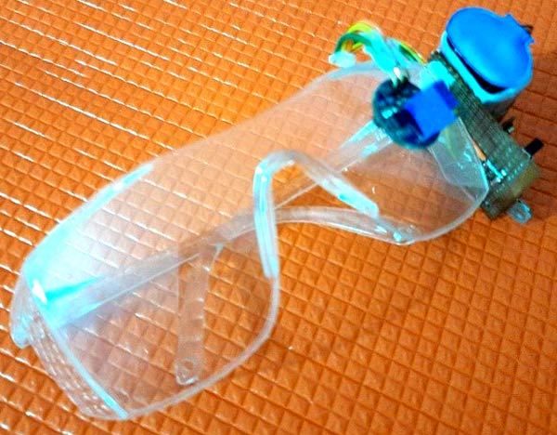
Project analysis slide 2
Hardware

Slide 6
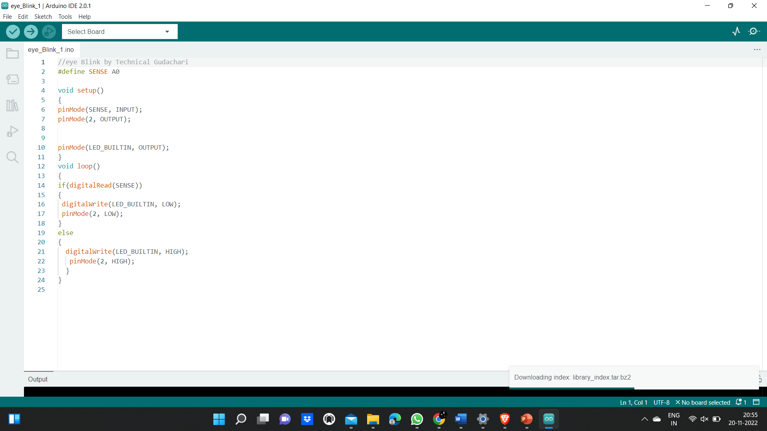

Slide 7
Project analysis slide 2
Result
The results for several conditions were calculated and tested to achieve high accuracy.
These conditions vary from person to person, with a person under observation having their eyes closed or open. The person could be someone who wears spectacles due to which might cause reflection of light and result in a glared image, making it difficult for feature extraction and feature selection.
So, to avoid these hindrances, the proposed model was tested against the above-mentioned constraints as well to achieve satisfactory results

Slide 8
Thank You

